Slide 1
COMP9024: Data Structures and Algorithms
Week Four: Stacks and Queues
Hui Wu
Session 2, 2015
http://www.cse.unsw.edu.au/~cs9024

Slide 2
Outline
Stacks
Queues

Slide 3
Stacks

Slide 4
Abstract Data Types (ADTs)
An abstract data type (ADT) is an abstraction of a data structure
An ADT specifies:
  Data stored
  Operations on the data
  Error conditions associated with operations
Example: ADT modeling a simple stock trading system
  The data stored are buy/sell orders
  The operations supported are
    order buy(stock, shares, price)
    order sell(stock, shares, price)
    void cancel(order)
  Error conditions:
    Buy/sell a nonexistent stock
    Cancel a nonexistent order

Slide 5
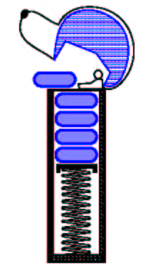
The Stack ADT
The Stack ADT stores arbitrary objects
Insertions and deletions follow the last-in first-out scheme
Think of a spring-loaded plate dispenser
Main stack operations:
  push(object): inserts an element
  object pop(): removes and returns the last inserted element
Auxiliary stack operations:
  object top(): returns the last inserted element without removing it
  integer size(): returns the number of elements stored
  boolean isEmpty(): indicates whether no elements are stored

Slide 6
Stack Interface in Java
Java interface corresponding to our Stack ADT
Requires the definition of class EmptyStackException
Different from the built-in Java class java.util.Stack
public interface Stack {
public int size();
public boolean isEmpty();
public Object top()
throws EmptyStackException;
public void push(Object o);
public Object pop()
throws EmptyStackException;
}

Slide 7
Exceptions
Attempting the execution of an operation of ADT may sometimes cause an error condition, called an exception
Exceptions are said to be “thrown” by an operation that cannot be executed
In the Stack ADT, operations pop and top cannot be performed if the stack is empty
Attempting the execution of pop or top on an empty stack throws an EmptyStackException

Slide 8
Applications of Stacks
Direct applications
  Page-visited history in a Web browser
  Undo sequence in a text editor
  Chain of method calls in the Java Virtual Machine
Indirect applications
  Auxiliary data structure for algorithms
  Component of other data structures

Slide 9
Method Stack in the JVM
The Java Virtual Machine (JVM) keeps track of the chain of active methods with a stack
When a method is called, the JVM pushes on the stack a frame containing
  Local variables and return value
  Program counter, keeping track of the statement being executed
When a method ends, its frame is popped from the stack and control is passed to the method on top of the stack
Allows for recursion
main() {
int i = 5;
foo(i);
}
foo(int j) {
int k;
k = j+1;
bar(k);
}
bar(int m) {
…
}
bar
PC = 1
m = 6
foo
PC = 3
j = 5
k = 6
main
PC = 2
i = 5

Slide 10
Array-based Stack (1/2)
A simple way of implementing the Stack ADT uses an array
We add elements from left to right
A variable keeps track of the index of the top element
Algorithm size()
{ return t + 1; }
Algorithm pop()
{ if ( isEmpty() )
throw EmptyStackException;
else
t = t − 1;
return S[t + 1];
}
…
S
0
1
2
t

Slide 11
Array-based Stack (2/2)
The array storing the stack elements may become full
A push operation will then throw a FullStackException
  Limitation of the array-based implementation
  Not intrinsic to the Stack ADT
Algorithm push(o)
{
if ( t = S.length − 1)
throw FullStackException;
else
{ t = t + 1;
S[t] = o;
}
}
…
S
0
1
2
t

Slide 12
Performance and Limitations
Performance
  Let n be the number of elements in the stack
  The space used is O(n)
  Each operation runs in time O(1)
Limitations
  The maximum size of the stack must be defined a priori and cannot be changed
  Trying to push a new element into a full stack causes an implementation-specific exception—Overflow.

Slide 13
Array-based Stack in Java
public class ArrayStack
implements Stack {
// holds the stack elements
private Object S[ ];
// index to top element
private int top = -1;
// constructor
public ArrayStack(int capacity) {
S = new Object[capacity]);
}
public Object pop()
throws EmptyStackException {
if isEmpty()
throw new EmptyStackException
(“Empty stack: cannot pop”);
Object temp = S[top];
// facilitates garbage collection
S[top] = null;
top = top – 1;
return temp;
}

Slide 14
Linked List-based Stack (1/4)
The top of the stack is the head of the linked list.
A instance variable keeps the current number of elements.
push: create a new node and add it at the top of the stack.
Pop: delete the node at the top of the stack.
Bottom
Top
Sydney
Rome
Seattle
New York

Slide 15
Linked List-based Stack (2/4)
The node class:
public class Node<E> { // Instance variables:
private E element;
private Node<E> next;
/** Creates a node with null references to its element and next node. */
public Node() { this(null, null); }
/** Creates a node with the given element and next node. */
public Node(E e, Node<E> n) { element = e; next = n; }
// Accessor methods:
public E getElement() { return element; }
public Node<E> getNext() { return next; } // Modifier methods:
public void setElement(E newElem) { element = newElem; }
public void setNext(Node<E> newNext) { next = newNext; }
}

Slide 16
Linked List-based Stack (3/4)
public class NodeStack<E> implements Stack<E> {
protected Node<E> top; // reference to the head node
protected int size; // number of elements in the stack
public NodeStack() { // constructs an empty stack
top = null; size = 0; }
public int size() { return size; }
public boolean isEmpty() { if (top == null) return true; return false; }
public void push(E elem) {
Node<E> v = new Node<E>(elem, top); // create and link-in a new node
top = v; size++; }
public E top() throws EmptyStackException {
if (isEmpty()) throw new EmptyStackException("Stack is empty.");
return top.getElement(); }
public E pop() throws EmptyStackException {
if (isEmpty()) throw new EmptyStackException("Stack is empty.");
E temp = top.getElement();
top = top.getNext(); // link-out the former top node
size--;
return temp; }
}

Slide 17
Linked List-based Stack (4/4)
Each of the methods of the Stack interface takes constant time.
Space complexity is O(n), where n is the number of elements on the stack.
No overflow problem as in array-based stack.

Slide 18
Parentheses Matching
Each “(”, “{”, or “[” must be paired with a matching “)”, “}”, or “[”
  correct: ( )(( )){([( )])}
  correct: (( )( )){([( )])}
  incorrect: )(( )){([( )])}
  incorrect: ({[ ])}
  incorrect: (

Slide 19
Parentheses Matching Algorithm
Algorithm ParenMatch(X,n):
{ Input: An array X of n tokens, each of which is either a grouping symbol, a variable, an arithmetic operator, or a number
Output: true if and only if all the grouping symbols in X match
Let S be an empty stack;
for ( i=0; i < n; i++)
if ( X[i] is an opening grouping symbol )
S.push(X[i]);
else if ( X[i] is a closing grouping symbol )
{
if ( S.isEmpty() )
return false; // nothing to match with
if ( S.pop() does not match the type of X[i] )
return false; // wrong type
}
if ( S.isEmpty() )
return true; // every symbol matched
else
return false; // some symbols were never matched
}

Slide 20
HTML Tag Matching
For fully-correct HTML, each <name> should pair with a matching </name>
<body>
<center>
<h1> The Little Boat </h1>
</center>
<p> The storm tossed the little
boat like a cheap sneaker in an
old washing machine. The three
drunken fishermen were used to
such treatment, of course, but
not the tree salesman, who even as
a stowaway now felt that he
had overpaid for the voyage. </p>
<ol>
<li> Will the salesman die? </li>
<li> What color is the boat? </li>
<li> And what about Naomi? </li>
</ol>
</body>
The Little Boat
The storm tossed the little boat
like a cheap sneaker in an old
washing machine. The three
drunken fishermen were used to
such treatment, of course, but not
the tree salesman, who even as
a stowaway now felt that he had
overpaid for the voyage.
1. Will the salesman die?
2. What color is the boat?
3. And what about Naomi?

Slide 21
Tag Matching Algorithm (1/3)
Is similar to parentheses matching:
  import java.io.*;
  import java.util.Scanner;
  import net.datastructures.*;
  /** Simplified test of matching tags in an HTML document. */
  public class HTML {
  /** Strip the first and last characters off a <tag> string. */
  public static String stripEnds(String t) {
  if (t.length() <= 2) return null; // this is a degenerate tag
  return t.substring(1,t.length()-1); }
  /** Test if a stripped tag string is empty or a true opening tag. */
  public static boolean isOpeningTag(String tag) {
  return (tag.length() == 0) || (tag.charAt(0) != '/'); }

Slide 22
Tag Matching Algorithm (2/3)
  /** Test if stripped tag1 matches closing tag2 (first character is '/'). */
  public static boolean areMatchingTags(String tag1, String tag2) {
  return tag1.equals(tag2.substring(1)); // test against name after '/' }
  /** Test if every opening tag has a matching closing tag. */
  public static boolean isHTMLMatched(String[] tag) {
  Stack<String> S = new NodeStack<String>(); // Stack for matching tags
  for (int i = 0; (i < tag.length) && (tag[i] != null); i++)
  {
  if (isOpeningTag(tag[i])) S.push(tag[i]); // opening tag; push it on the stack
  else { if (S.isEmpty()) return false; // nothing to match
  if (!areMatchingTags(S.pop(), tag[i])) return false; // wrong match
  }
  }
  if (S.isEmpty()) return true; // we matched everything
  return false; // we have some tags that never were matched }

Slide 23
Tag Matching Algorithm (3/3)
  public final static int CAPACITY = 1000; // Tag array size
  /* Parse an HTML document into an array of html tags */
  public static String[] parseHTML(Scanner s) {
  String[] tag = new String[CAPACITY]; // our tag array (initially all null)
  int count = 0; // tag counter
  String token; // token returned by the scanner s
  while (s.hasNextLine())
  { while ((token = s.findInLine("<[^>]*>")) != null) // find the next tag
  tag[count++] = stripEnds(token); // strip the ends off this tag
  s.nextLine(); // go to the next line
  }
  return tag; // our array of (stripped) tags }
  public static void main(String[] args) throws IOException { // tester
  if (isHTMLMatched(parseHTML(new Scanner(System.in))))
  System.out.println("The input file is a matched HTML document.");
  else
  System.out.println("The input file is not a matched HTML document."); } }

Slide 24
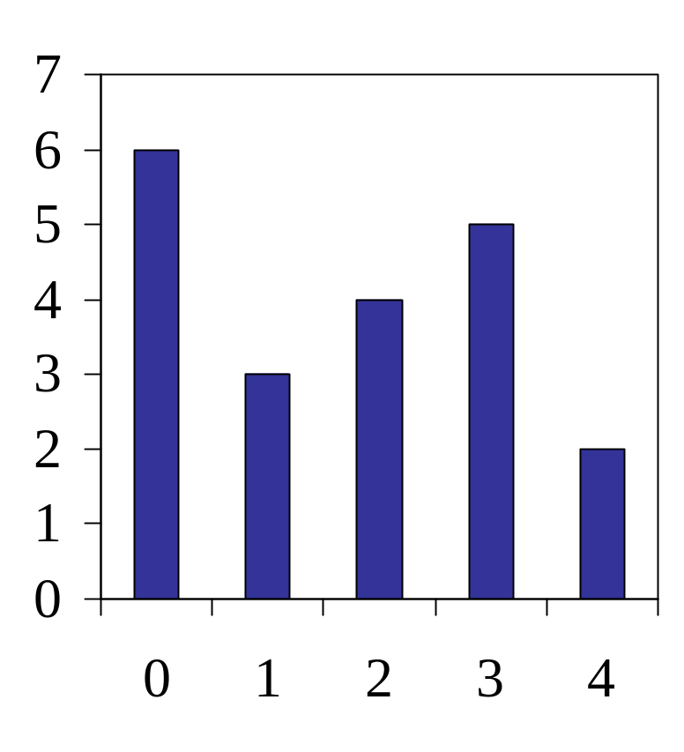
Computing Spans (not in book)
We show how to use a stack as an auxiliary data structure in an algorithm
Given an an array X, the span S[i] of X[i] is the maximum number of consecutive elements X[j] immediately preceding X[i] and such that X[j] ≤ X[i]
Spans have applications to financial analysis
  E.g., stock at 52-week high
X
6 | 3 | 4 | 5 | 2
1 | 1 | 2 | 3 | 1
S

Slide 25
Quadratic Algorithm
Algorithm spans1(X, n)
{
Input array X of n integers
Output array S of spans of X #
S = new array of n integers; n
for ( i = 0; i < n; i++) n
{ s = 1; n
while ( s ≤ i ∧ X[i − s] ≤ X[i] ) 1 + 2 + …+ (n − 1)
s = s + 1; 1 + 2 + …+ (n − 1)
S[i] = s; n
}
return S; 1
}
Algorithm spans1 runs in O(n²) time

Slide 26
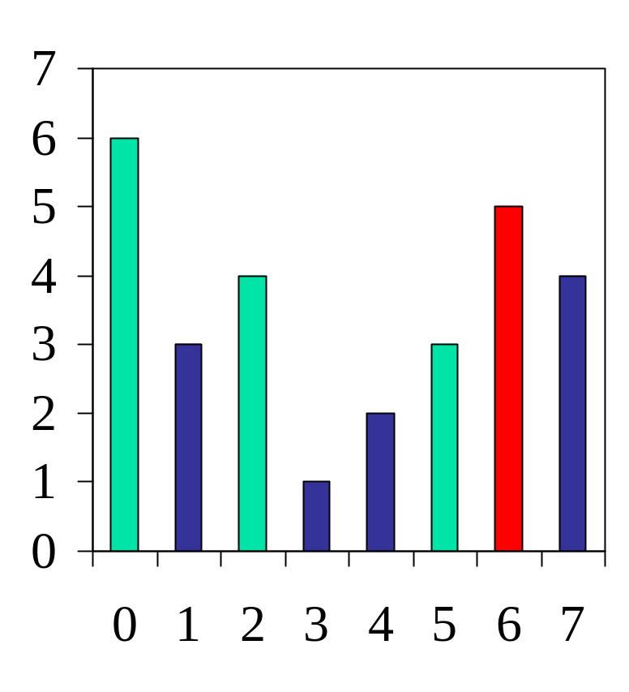
Computing Spans with a Stack
We keep in a stack the indices of the elements visible when “looking back”
We scan the array from left to right
  Let i be the current index
  We pop indices from the stack until we find index j such that X[i] < X[j]
  We set S[i] ← i − j
  We push i onto the stack

Slide 27
Linear Algorithm
Each index of the array
  Is pushed into the stack exactly one
  Is popped from the stack at most once
The statements in the while-loop are executed at most n times
Algorithm spans2 runs in O(n) time
Algorithm spans2(X, n) #
{ S = new array of n integers; n
A = new empty stack; 1
for ( i = 0; i < n, i ++ ) n
{
while (¬A.isEmpty() ∧
X[A.top()] ≤ X[i] ) n
A.pop(); n
if ( A.isEmpty() ) n
S[i] = i + 1; n
else
S[i] = i − A.top(); n
A.push(i); n
}
return S; 1
}

Slide 28
Queues

Slide 29
The Queue ADT
The Queue ADT stores arbitrary objects
Insertions and deletions follow the first-in first-out scheme
Insertions are at the rear of the queue and removals are at the front of the queue
Main queue operations:
  enqueue(object): inserts an element at the end of the queue
  object dequeue(): removes and returns the element at the front of the queue
Auxiliary queue operations:
  object front(): returns the element at the front without removing it
  integer size(): returns the number of elements stored
  boolean isEmpty(): indicates whether no elements are stored
Exceptions
  Attempting the execution of dequeue or front on an empty queue throws an EmptyQueueException

Slide 30
Queue Example
Operation Output Q
enqueue(5) – (5)
enqueue(3) – (5, 3)
dequeue() 5 (3)
enqueue(7) – (3, 7)
dequeue() 3 (7)
front() 7 (7)
dequeue() 7 ()
dequeue() “error” ()
isEmpty() true ()
enqueue(9) – (9)
enqueue(7) – (9, 7)
size() 2 (9, 7)
enqueue(3) – (9, 7, 3)
enqueue(5) – (9, 7, 3, 5)
dequeue() 9 (7, 3, 5)

Slide 31
Applications of Queues
Direct applications
  Waiting lists, bureaucracy
  Access to shared resources (e.g., printer)
  Multiprogramming
Indirect applications
  Auxiliary data structure for algorithms
  Component of other data structures

Slide 32
Array-based Queue
Use an array of size N in a circular fashion
Two variables keep track of the front and rear
  f index of the front element
  r index immediately past the rear element
Array location r is kept empty
normal configuration
Q
0
1
2
f
r
wrapped-around configuration
Q
0
1
2
r
f

Slide 33
Queue Operations (1/3)
Algorithm size()
{ return (N − f + r) mod N;}
Algorithm isEmpty()
{ return (f = r); }
We use the modulo operator (remainder of division)
Q
0
1
2
f
r
Q
0
1
2
r
f

Slide 34
Queue Operations (2/3)
Operation enqueue throws an exception if the array is full
This exception is implementation-dependent
Algorithm enqueue(o)
{ if ( size() = N − 1)
throw FullQueueException;
else
{ Q[r] = o;
r = (r + 1) mod N ;
}
}
Q
0
1
2
f
r
Q
0
1
2
r
f

Slide 35
Queue Operations (3/3)
Operation dequeue throws an exception if the queue is empty
This exception is specified in the queue ADT
Algorithm dequeue()
{ if ( isEmpty() )
throw EmptyQueueException
else
{ o = Q[f];
f = (f + 1) mod N;
return o;
}
}
Q
0
1
2
f
r
Q
0
1
2
r
f

Slide 36
Queue Interface in Java
Java interface corresponding to our Queue ADT
Requires the definition of class EmptyQueueException
No corresponding built-in Java class
public interface Queue {
public int size();
public boolean isEmpty();
public Object front()
throws EmptyQueueException;
public void enqueue(Object o);
public Object dequeue()
throws EmptyQueueException;
}

Slide 37
Linked List-based Implementation of Queue (1/2)
A generic singly linked list is used to implement queue.
The front of the queue is the head of the linked list and the rear of the queue is the tail of the linked list.
The queue class needs to maintain references to both head and tail nodes in the list.
Each method of the singly linked list implementation of queue ADT runs in O(1) time.
Two methods, namely dequeue() and enqueue(), are given on the next slide.

Slide 38
Linked List-based Implementation of Queue (2/2)
public void enqueue(E elem) {
Node<E> node = new Node<E>();
node.setElement(elem);
node.setNext(null); // node will be new tail node
if (size == 0) head = node; // special case of a previously empty queue
else tail.setNext(node); // add node at the tail of the list
tail = node; // update the reference to the tail node
size++; }
public E dequeue() throws EmptyQueueException {
if (size == 0) throw new EmptyQueueException("Queue is empty.");
E tmp = head.getElement();
head = head.getNext();
size--;
if (size == 0) tail = null; // the queue is now empty
return tmp; }

Slide 39
Application 1: Round Robin Schedulers
We can implement a round robin scheduler using a queue, Q, by repeatedly performing the following steps:
  e = Q.dequeue()
  Service element e
  Q.enqueue(e)
The Queue
1
.
Deque the
2
.
Service the
3
.
Enqueue the
next element
next element
serviced element
Shared
Service

Slide 40
Application 2: The Josephus Problem (1/4)
A group of children sit in a circle passing an object, called “potato”, around the circle.
The potato begins with a starting child in the circle, and the children continue passing the potato until a leader rings a bell, at which point the child holding the potato must leave the game after handing the potato to the next child in the circle.
After the selected child leaves, the other children close up the circle.

Slide 41
Application 2: The Josephus Problem (2/4)
This process then continues until there is only child remaining, who is declared the winner.
If the leader always uses the strategy of ringing the bell after the potato has been passed k times, for some fixed k, determining the winner for a given list of children is known as the josephus problem.

Slide 42
Application 2: The Josephus Problem (3/4)
  import net.datastructures.*;
  public class Josephus { /** Solution of the Josephus problem using a queue. */ public static <E> E Josephus(Queue<E> Q, int k) {
  if (Q.isEmpty()) return null;
  while (Q.size() > 1) {
  System.out.println(" Queue: " + Q + " k = " + k);
  for (int i=0; i < k; i++)
  Q.enqueue(Q.dequeue()); // move the front element to the end
  E e = Q.dequeue(); // remove the front element from the collection
  System.out.println(" " + e + " is out"); }
  return Q.dequeue(); // the winner }

Slide 43
Application 2: The Josephus Problem (4/4)
  /** Build a queue from an array of objects */
  public static <E> Queue<E> buildQueue(E a[]) {
  Queue<E> Q = new NodeQueue<E>();
  for (int i=0; i<a.length; i++) Q.enqueue(a[i]); return Q; }
    /** Tester method */
    public static void main(String[] args) {
    String[] a1 = {"Alice", "Bob", "Cindy", "Doug", "Ed", "Fred"};
    String[] a2 = {"Gene", "Hope", "Irene", "Jack", "Kim", "Lance"};
    String[] a3 = {"Mike", "Roberto"};
    System.out.println("First winner is " + Josephus(buildQueue(a1), 3)); System.out.println("Second winner is " + Josephus(buildQueue(a2), 10)); System.out.println("Third winner is " + Josephus(buildQueue(a3), 7));
    } }

Slide 44
References
Chapter 5, Data Structures and Algorithms by Goodrich and Tamassia.

